Slide 1
Jane’s View

Slide 2
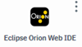
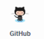
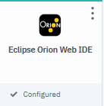
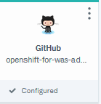
Brokers:
app1

Slide 3
Champ’s View (Kabanero Managed Pipelines and Event Triggers)

Slide 4

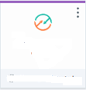


Brokers:
Tekton
events
webhook
Start with blank slate, and additional brokers

Slide 5
Openshift
Brokers:
Tekton
events
webhook
kabanero
Install Kabanero

Slide 6
Openshift
Brokers:
Tekton
events
webhook
kabanero
Tekton
Kab1
event
Event- Trigger
pipeline
Create Kabanero Instance

Slide 7
Openshift
Brokers:
Tekton
events
webhook
kabanero
Tekton
Kab1
Listener PR
event
Listener Push
Listener Tag
Event- Trigger
pipeline
Create OTC Tekton Pipeline Services

Slide 8
Openshift
Brokers:
Tekton
events
webhook
kabanero
Tekton
Kab1
Listener PR
event
Listener Push
webhook
Listener Tag
org
Event- Trigger
pipeline
Create ORG webhook

Slide 9
Openshift
Brokers:
Tekton
events
webhook
kabanero
Tekton
Kab1
Listener PR
event
Listener Push
webhook
Listener Tag
org
Event- Trigger
pipeline
Create NATS topic

Slide 10
Openshift
Brokers:
Tekton
events
webhook
kabanero
Tekton
Kab1
Listener PR
event
tri
Listener Push
trigger1
webhook
Listener Tag
org
Event- Trigger
pipeline
Create Event Trigger

Slide 11
Openshift
Brokers:
Tekton
events
webhook
kabanero
Tekton
Kab1
Listener PR
event
tri
Listener Push
trigger1
webhook
Listener Tag
org
Event- Trigger
pipeline
Link event senders/receivers

Slide 12
Not Kabanero Managed

Slide 13
Openshift
Brokers:
Tekton
events
webhook
tri
Listener PR
trigger1
Listener Push
webhook
Listener Tag
org
Event- Trigger
pipeline
Link event senders/receivers

Slide 14
Backup

Slide 15
Openshift
Brokers:
Tekton
events
webhook
kabanero
tri
Kab1
Listener PR
trigger1
Tekton
Listener Push
events
kab1
webhook
Listener Tag
org
Event- Trigger
pipeline
Link event senders/receivers

Slide 16
Openshift
Brokers:
Tekton
events
webhook
kabanero
Kab1
Listener PR
tri
Listener Push
trigger1
kab1
webhook
Listener Tag
app1
org
Event- Trigger
pipeline
Link event senders/receivers

Slide 17
Openshift
Brokers:
Tekton
events
webhook
kabanero
tri
Kab1
Listener PR
trigger1
Tekton
Listener Push
events
kab1
webhook
Listener Tag
app1
org
Event- Trigger
pipeline
Link event senders/receivers

Slide 18
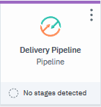
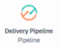
Tekton
events
events
webhook
Tekton
publisher
subscriber
sender
listener
event
event
webhook

